Slide 1

CS47: Cross-Platform Mobile Development
Lecture 8B: Deploying an App + Detaching
Faculty Advisor
Instructor #1
Fall 2019
https://class.website
class.slack.com

Slide 2

Announcements
Final Project Presentations
Tuesday, December 3rd
Thursday, December 5th

Slide 3

Overview for Today
How to Deploy an App
How to/Why Detach

Slide 4
Expo Docs on Deploying
Deploy
The docs are p nice, and deploying isn’t the worst thing in the world

Slide 5
Steps
Configure App.Json
Build Ios .ipa and Android APK
expo build:android
expo build:ios
Submit the files to the appropriate App Store

Slide 6
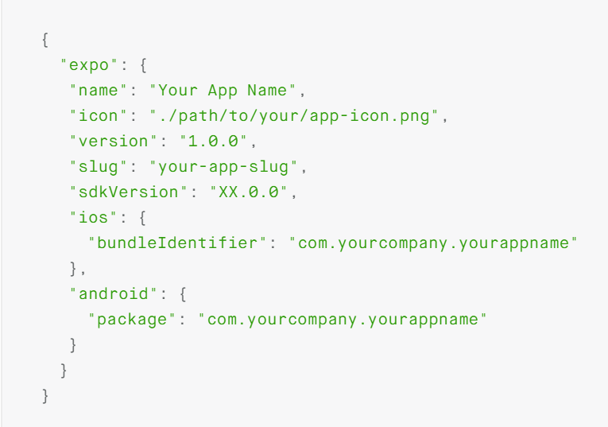
Configure App.Json
Make sure to update bundleIdentifier
Make sure to add “splash” category/unique splash screen
Must be .png file
Other configs
https://docs.expo.io/versions/latest/workflow/configuration.html

Slide 7
Actually Building the APK/IPA
Android
expo build:android
MAKE SURE YOU BACK UP KEYSTORE
The keystore is what you need to update your app
Expo can generate one, or you can upload your own
If expo generates a keystore, run “expo fetch:android:keystore” and back up the keystore
IOS
expo build:ios
Note: can be iffy on Windows
I’ve had to deploy using MACs
We recommend letting expo handle credentials
https://docs.expo.io/versions/latest/guides/building-standalone-apps.html

Slide 8
Actually submitting to App Stores
Make sure you have appropriate accounts
Google Play is $25 for life
Apple App Store is $99 a year because Apple
Make sure you have all info needed
App Icon
No transparency
Description
Know the Categories
Screenshots
Android
Have to have a banner photo
IOS
Read all guidelines because they’ll reject you for anything

Slide 9
Common Rejections
https://developer.apple.com/app-store/review/rejections/
They reject for anything so be careful. Especially with Login Stuff

Slide 10
Detaching

Slide 11


Slide 12
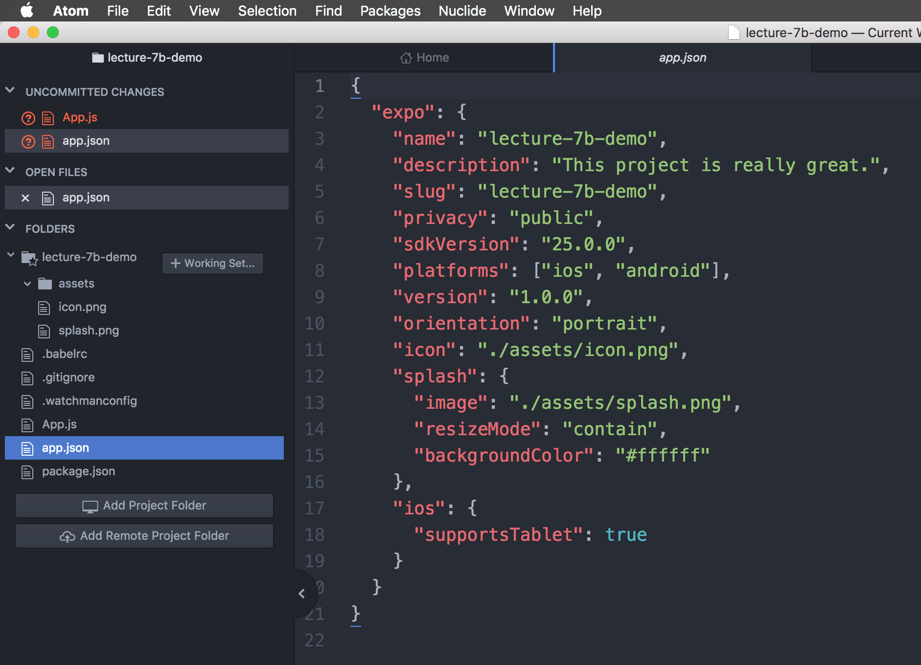


Slide 13
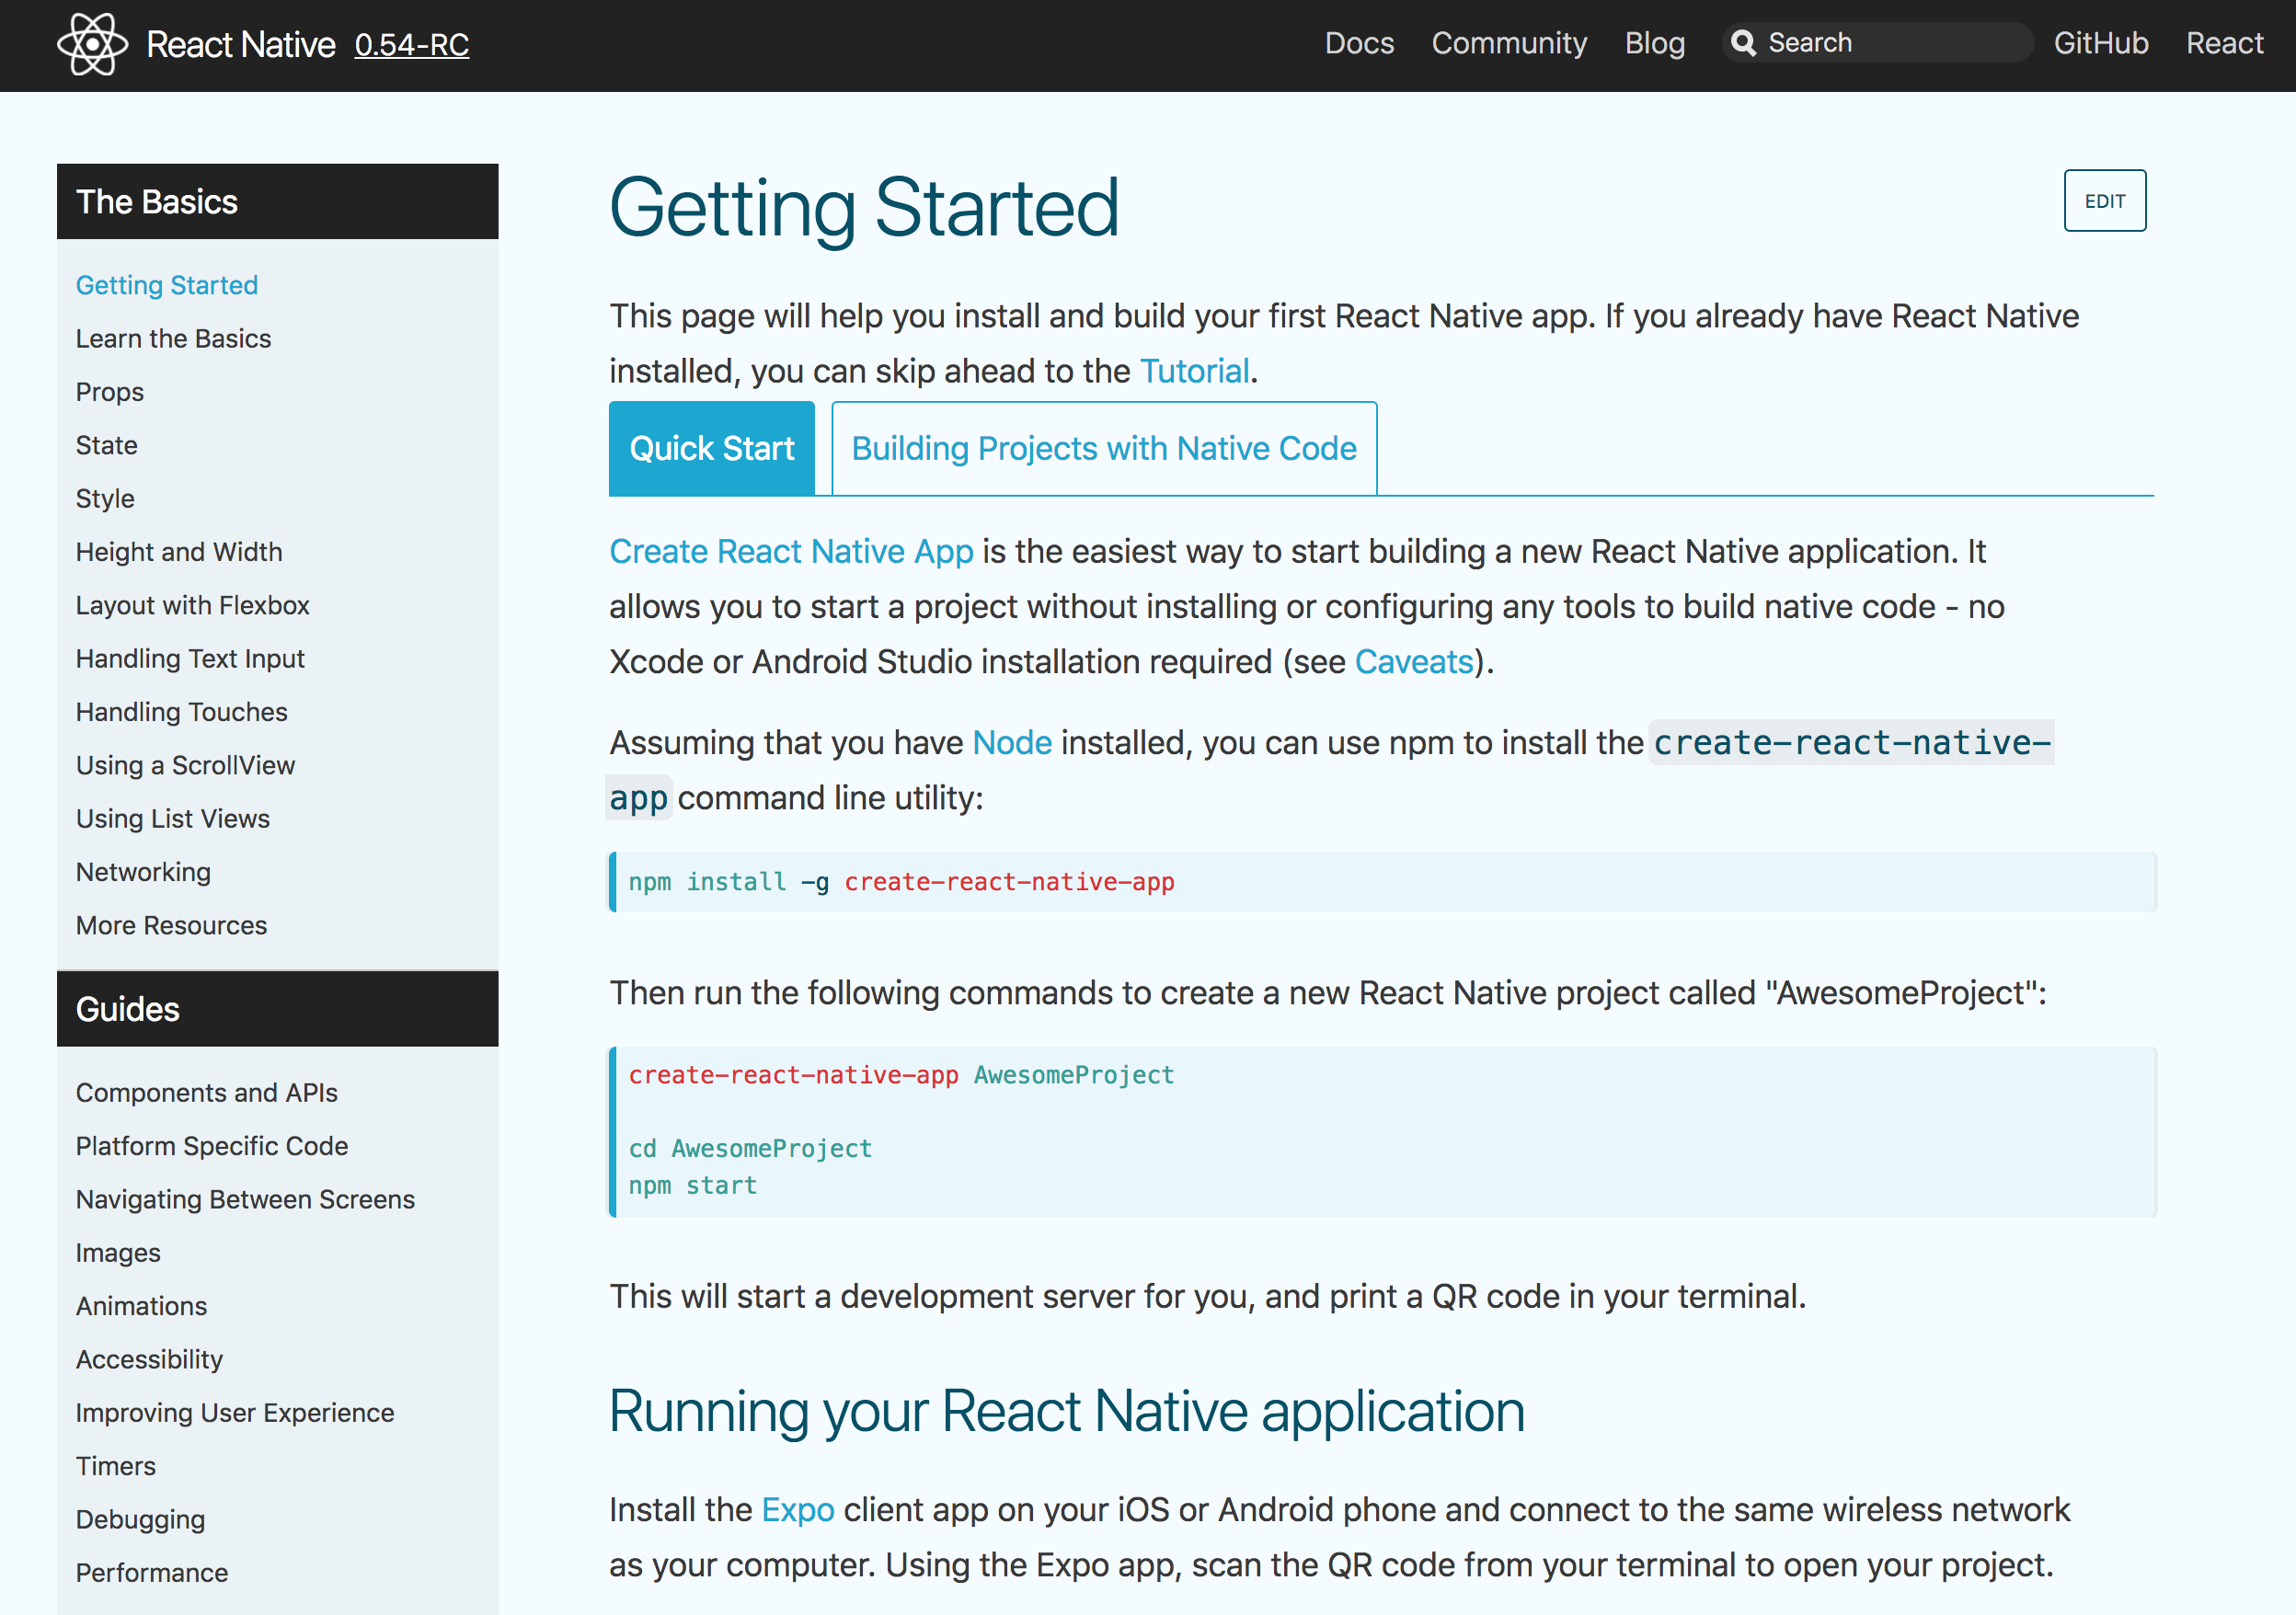

Slide 16
Are there any cases in which we want to have a React Native app, but still have the ability to write native Objective-C/Swift/Java code?

Slide 17
Are there any cases in which we want to have a React Native app, but still have the ability to write native Objective-C/Swift/Java code?
(spoiler: yes)

Slide 18
Are there any cases in which we want to have a React Native app, but still have the ability to write native Objective-C/Swift/Java code?
(spoiler: yes)
But when?
Notes:
-> Facebook’s Philosophy

Slide 19
“Sometimes an app needs access to platform API, and React Native doesn't have a corresponding module yet. Maybe you want to reuse some existing Java, Objective-C, Swift or C++ code without having to reimplement it in JavaScript, or write some high performance, multi-threaded code such as for image processing, a database, or any number of advanced extensions… If React Native doesn't support a native feature that you need, you should be able to build it yourself.”
-Facebook

Slide 20
“Sometimes an app needs access to platform API, and React Native doesn't have a corresponding module yet. Maybe you want to reuse some existing Java, Objective-C, Swift or C++ code without having to reimplement it in JavaScript, or write some high performance, multi-threaded code such as for image processing, a database, or any number of advanced extensions… If React Native doesn't support a native feature that you need, you should be able to build it yourself.”
-Facebook
Determining if you need to build a project with Native Code
1st) does React Native support the native features that you need?

Slide 21




“Sometimes an app needs access to platform API, and React Native doesn't have a corresponding module yet. Maybe you want to reuse some existing Java, Objective-C, Swift or C++ code without having to reimplement it in JavaScript, or write some high performance, multi-threaded code such as for image processing, a database, or any number of advanced extensions… If React Native doesn't support a native feature that you need, you should be able to build it yourself.”
-Facebook
Determining if you need to build a project with Native Code
1st) does React Native support the native features that you need?
Yes
No
No native code!

Slide 22
How can I determine if React Native doesn't support a native feature that I need?
https://facebook.github.io/react-native/docs/getting-started.html
https://docs.expo.io/versions/latest/index.html

Slide 23


Slide 25
Using some third party libraries also requires a project with native code

Slide 26
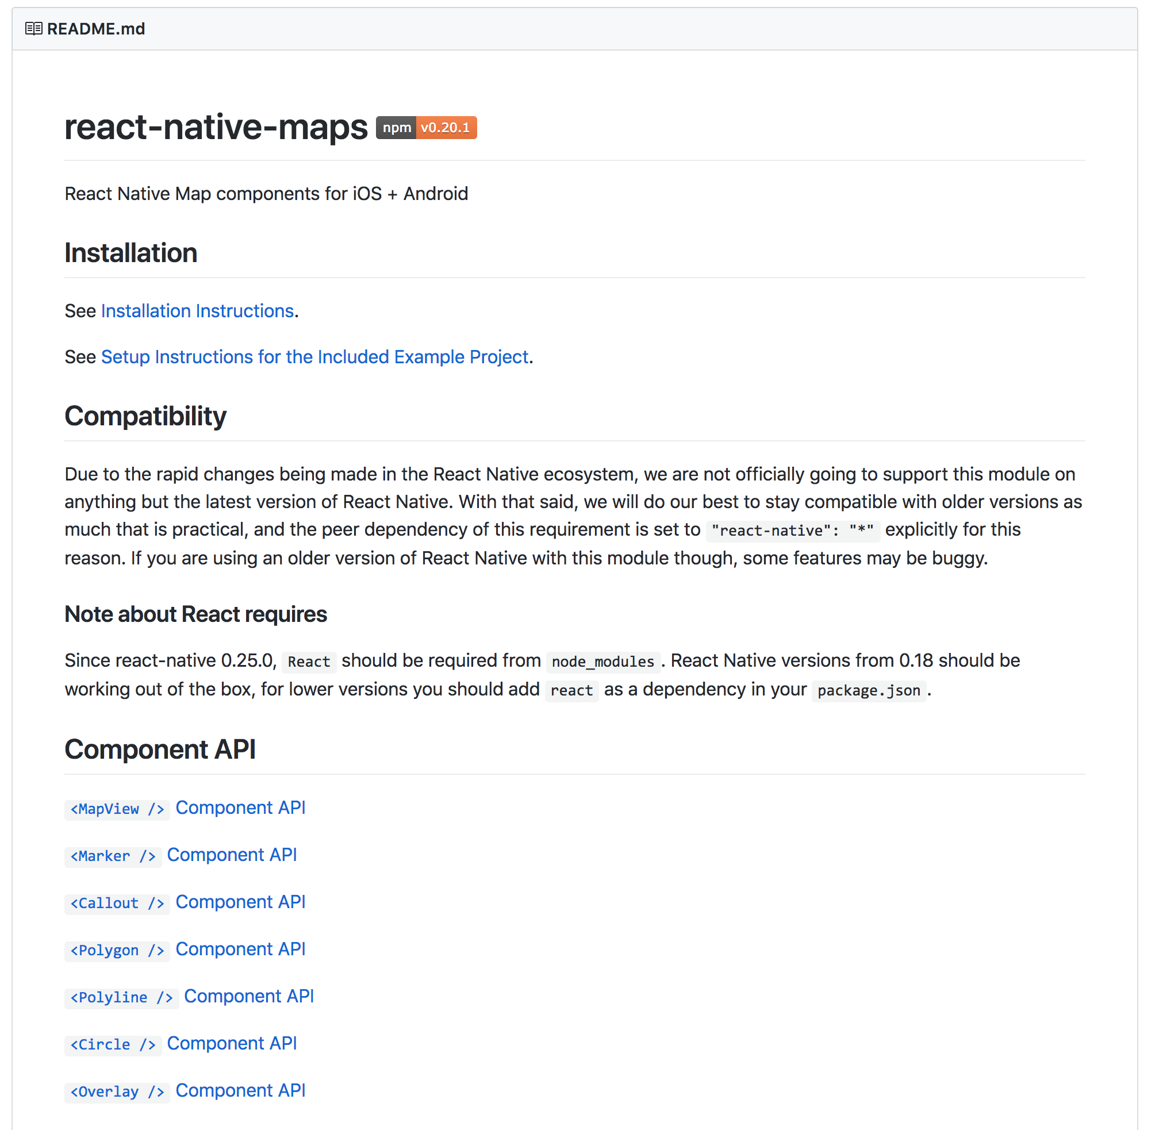
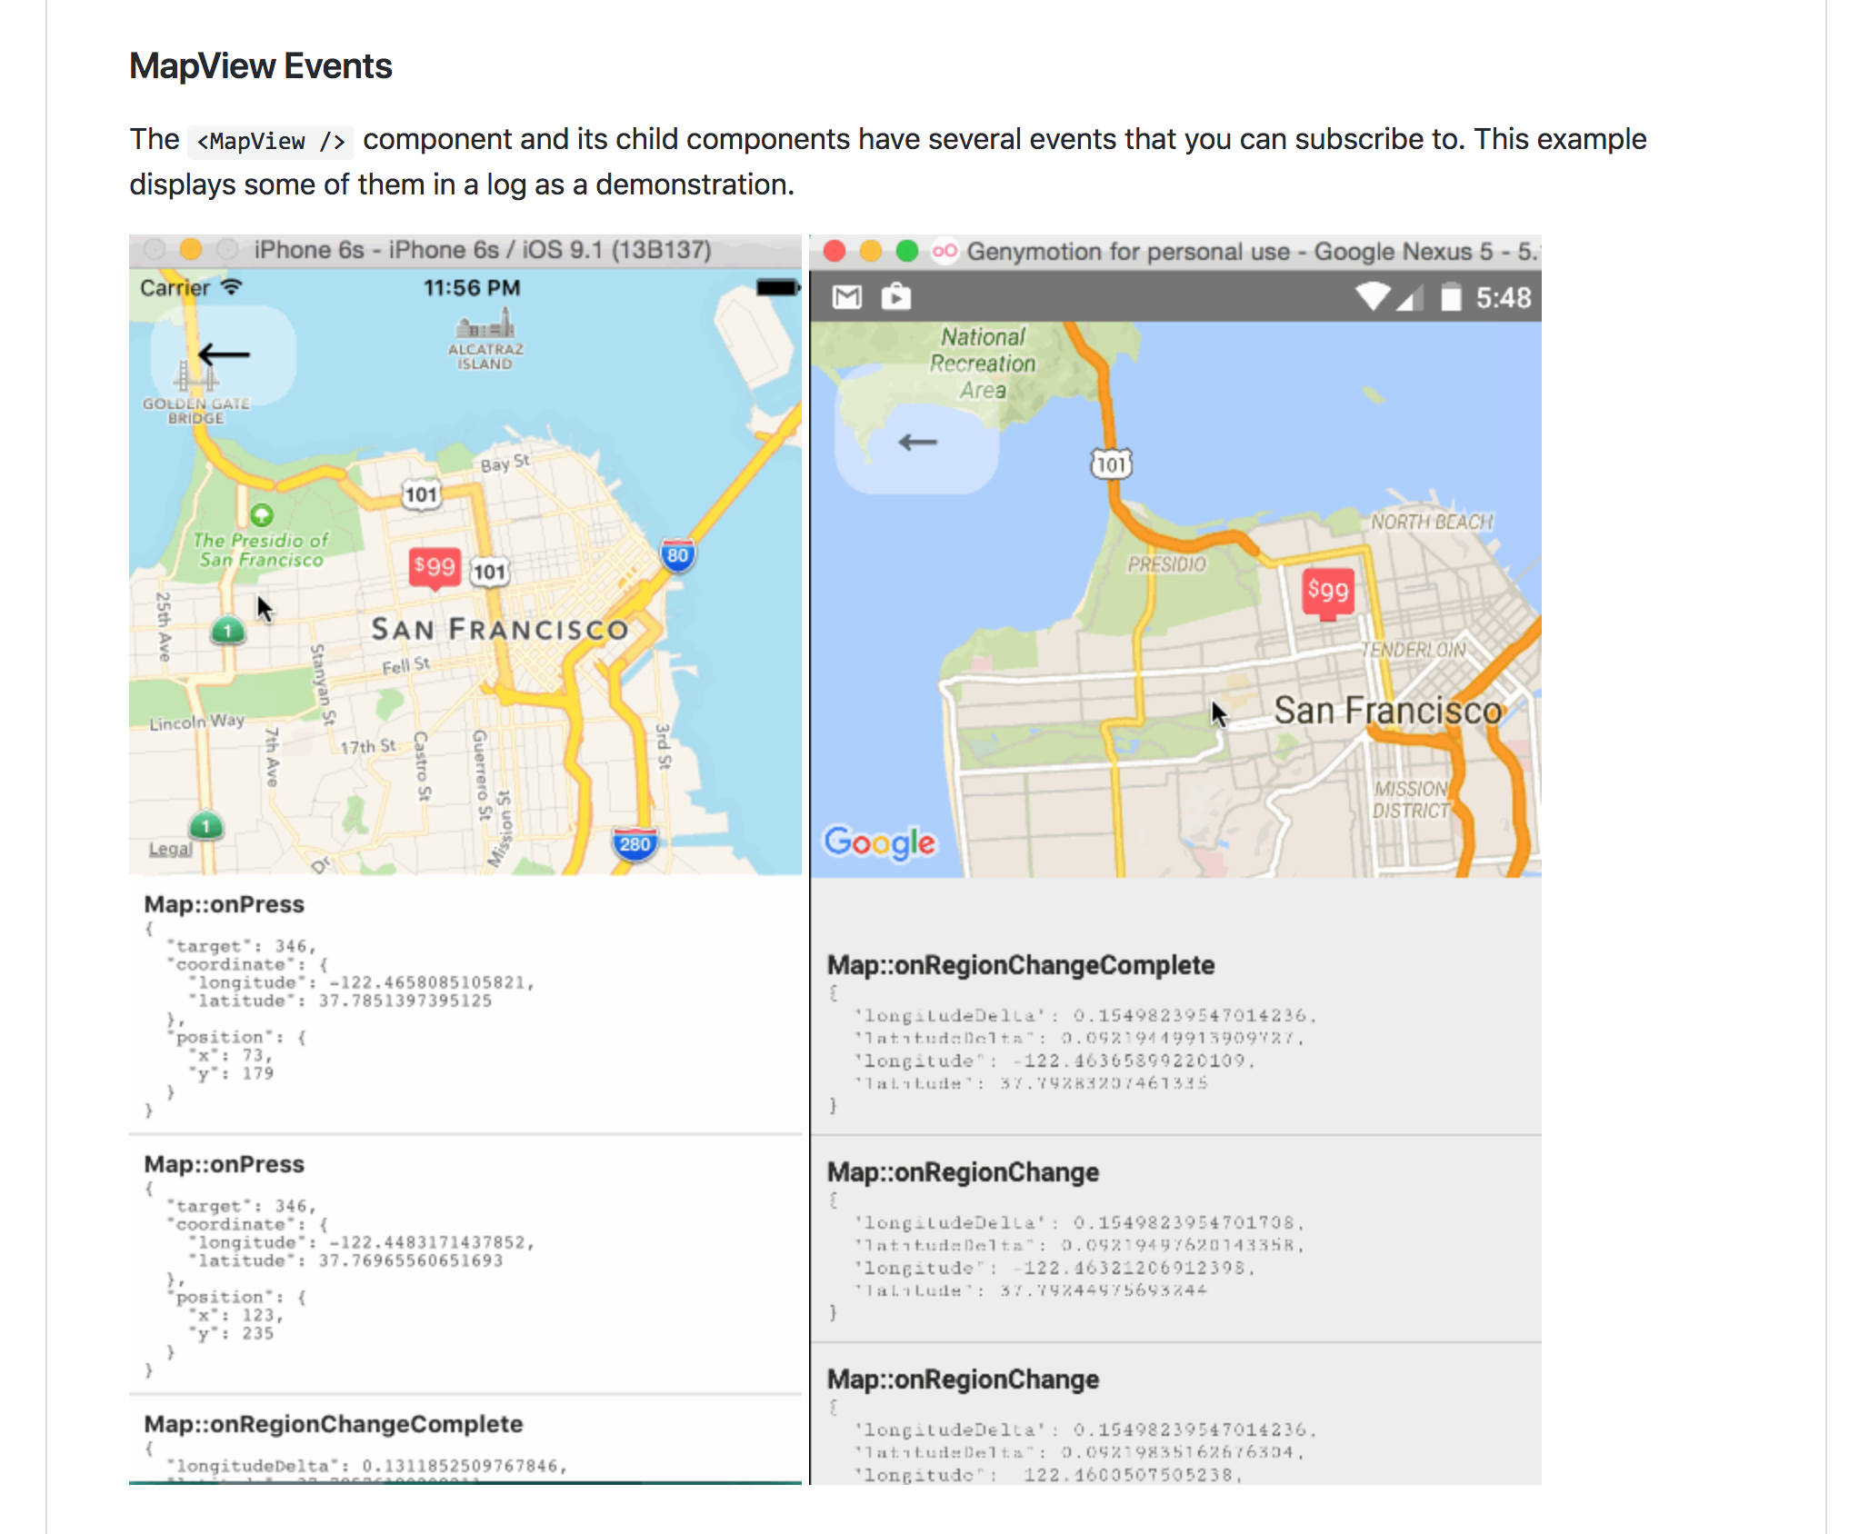
Using some third party libraries also requires a project with native code

Slide 27
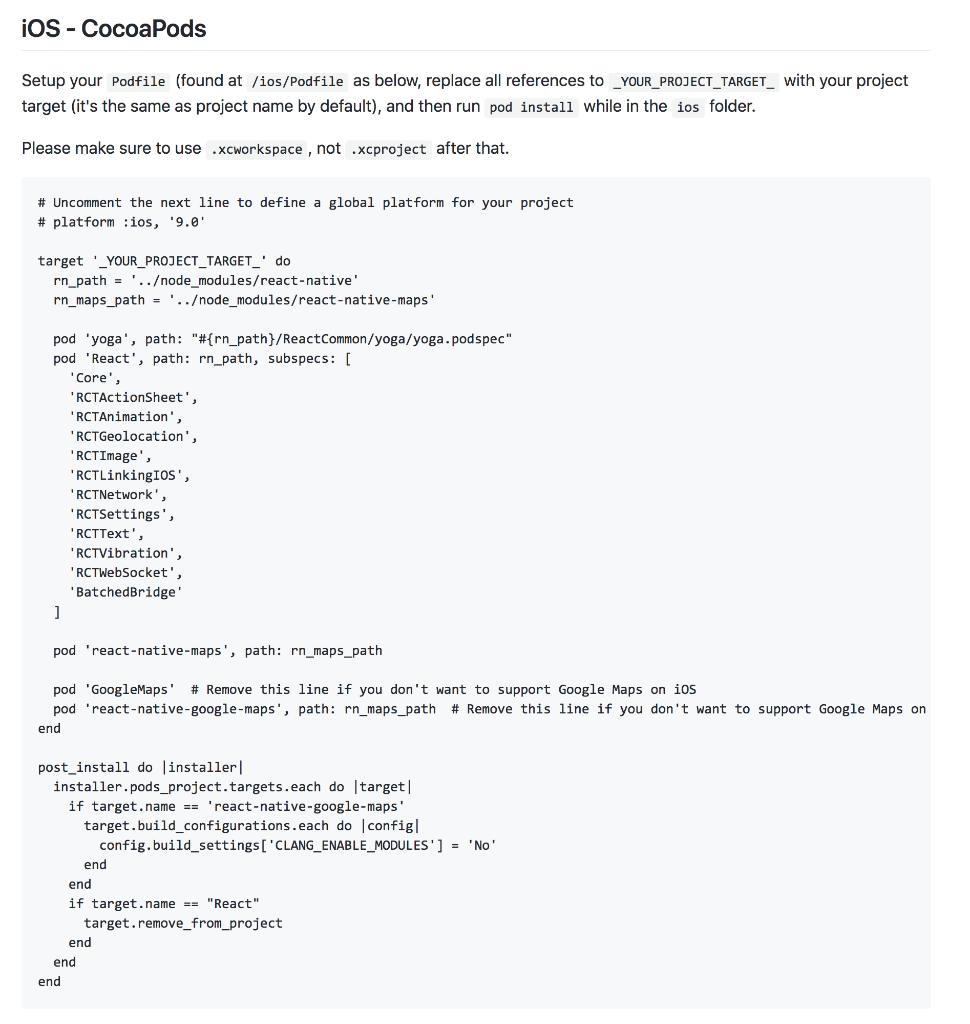
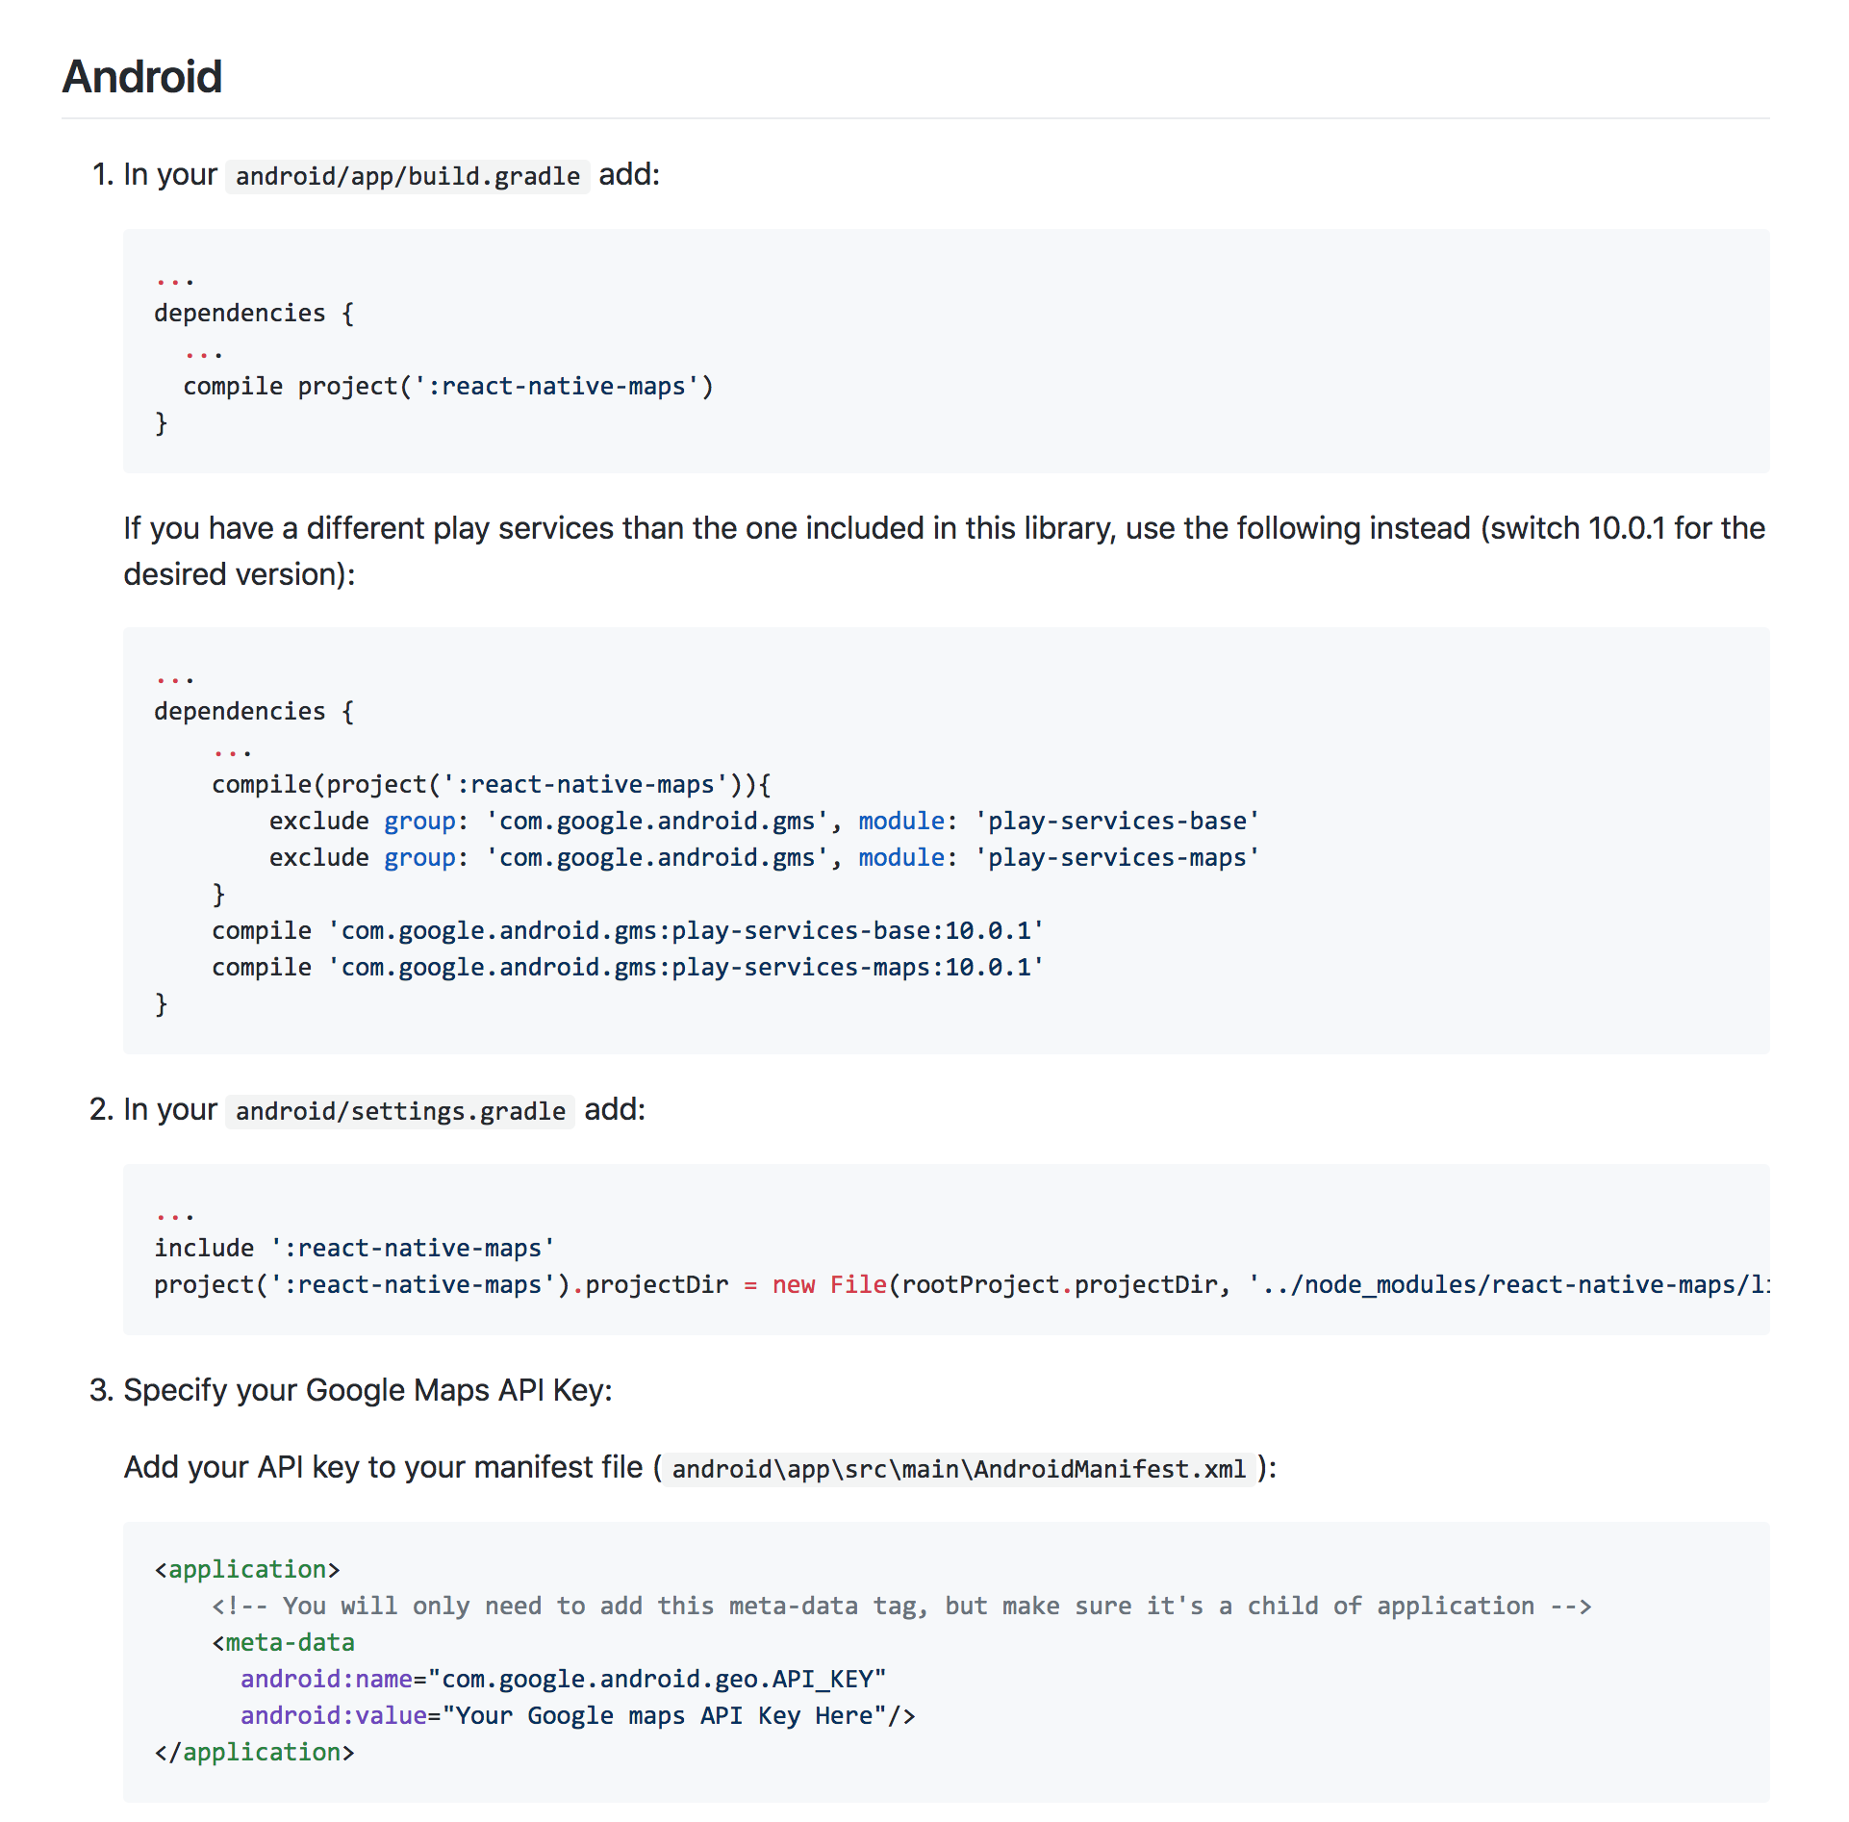
Using some third party libraries also requires a project with native code

Slide 28
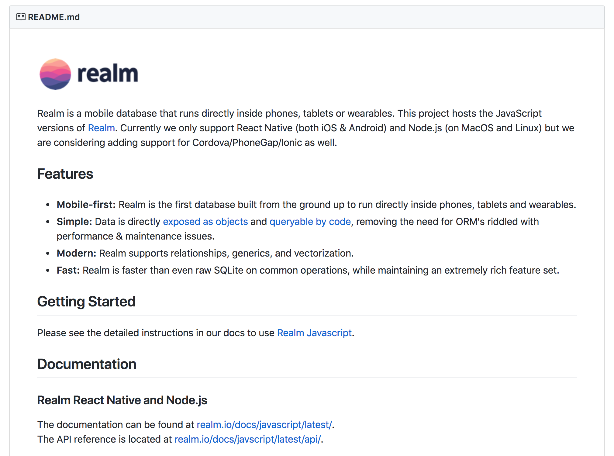
Using some third party libraries also requires a project with native code

Slide 29
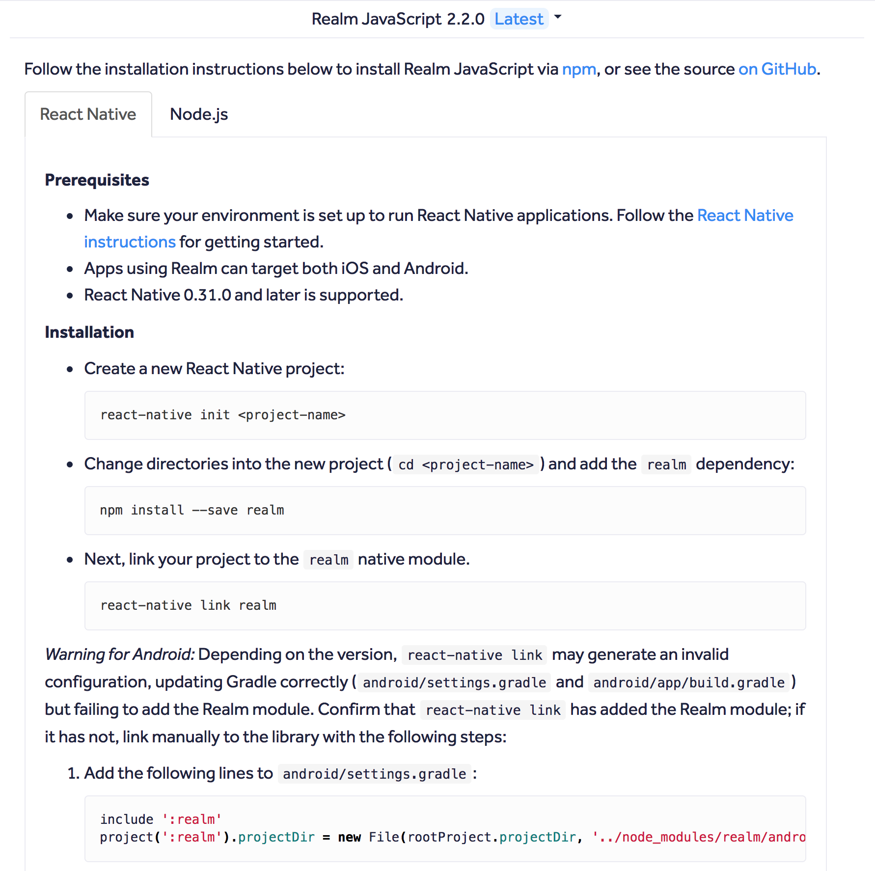
Using some third party libraries also requires a project with native code

Slide 30
How do I create a project with native code?

Slide 31
How do I create a project with native code?
One of two things will typically happen:
You will create an Expo project, later realize that you need native code, and will then want to “detach”
You will create a project with native code from the start

Slide 32
How do I create a project with native code?
One of two things will typically happen:
You will create an Expo project, later realize that you need native code, and will then want to “detach”
You will create a project with native code from the start

Slide 33
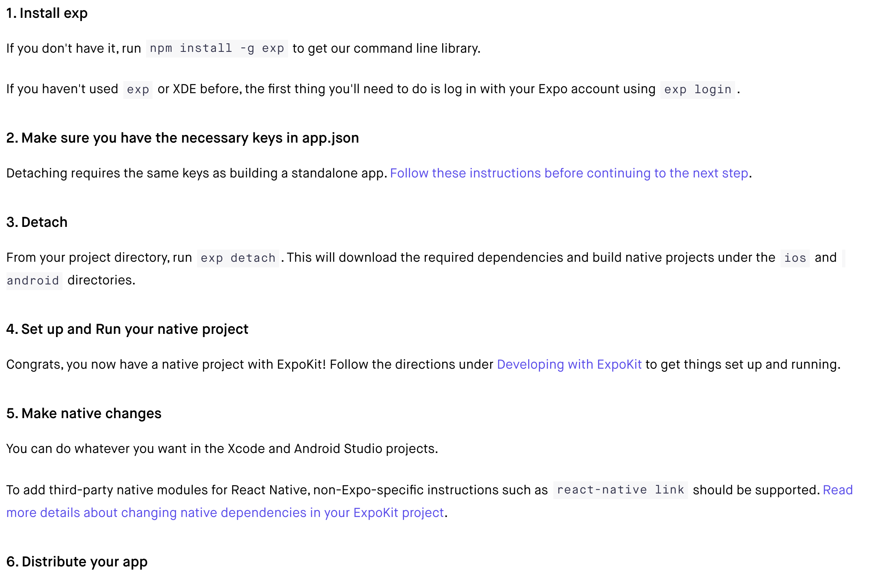

Slide 36
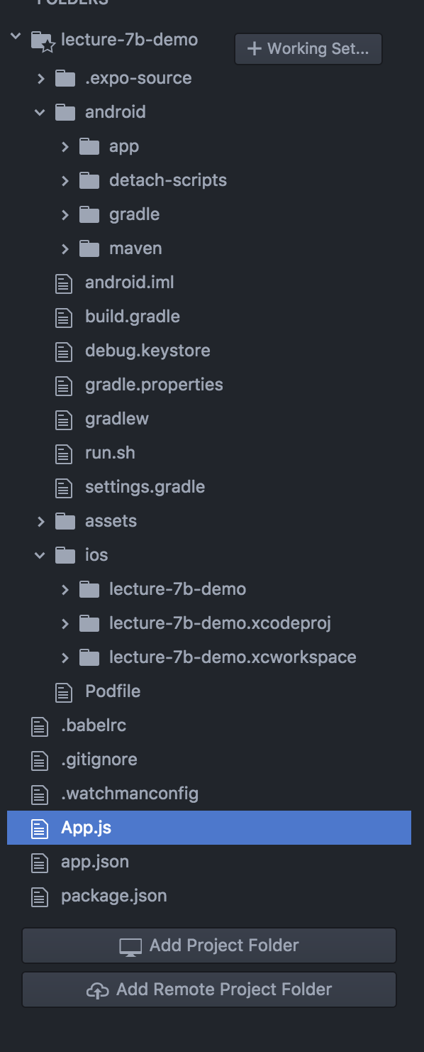

Slide 37


Slide 38
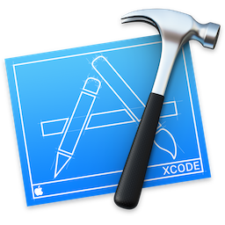

Slide 39


Slide 40
You will still get to enjoy RN benefits such as live reloading. However, initiating the app instance must be done through XCode or Android Studio.
(that means making sure that your dev environment is setup properly)

Slide 41
How do I create a project with native code?
One of two things will typically happen:
You will create an Expo project, later realize that you need native code, and will then want to “detach”
You will create a project with native code from the start

Slide 42
How do I create a project with native code?
One of two things will typically happen:
You will create an Expo project, later realize that you need native code, and will then want to “detach”
You will create a project with native code from the start

Slide 43
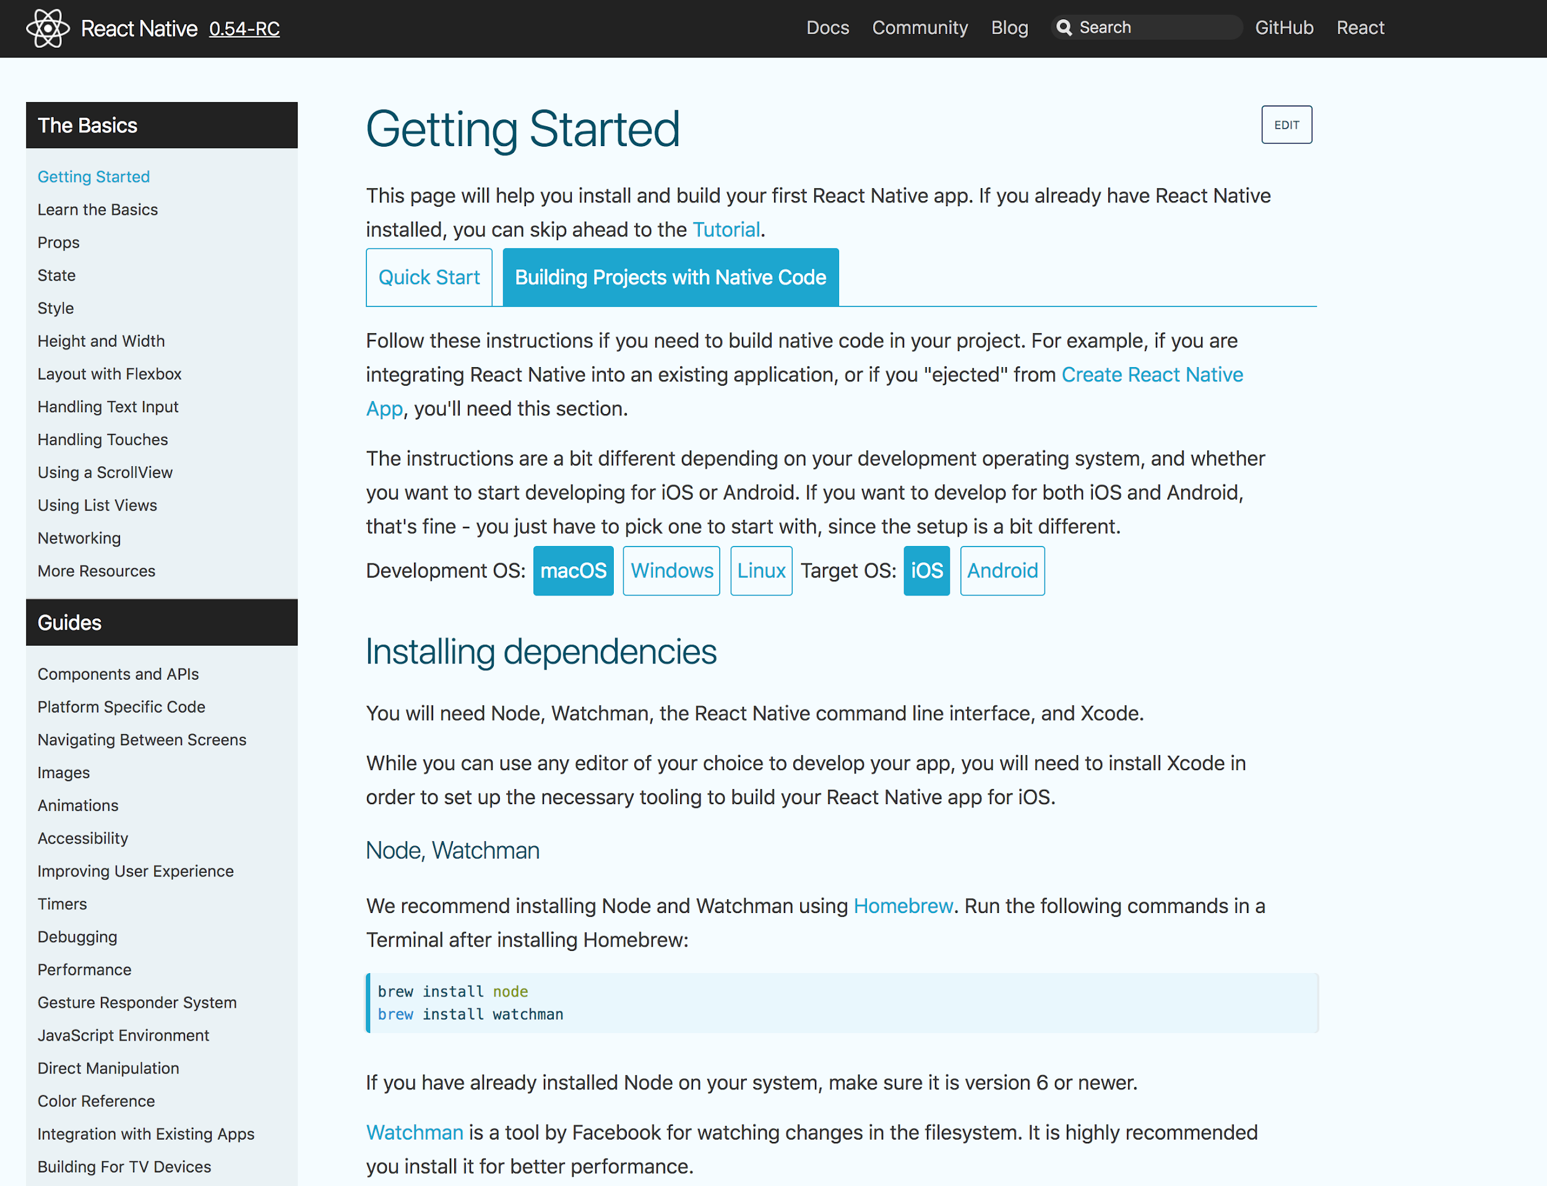

Slide 44
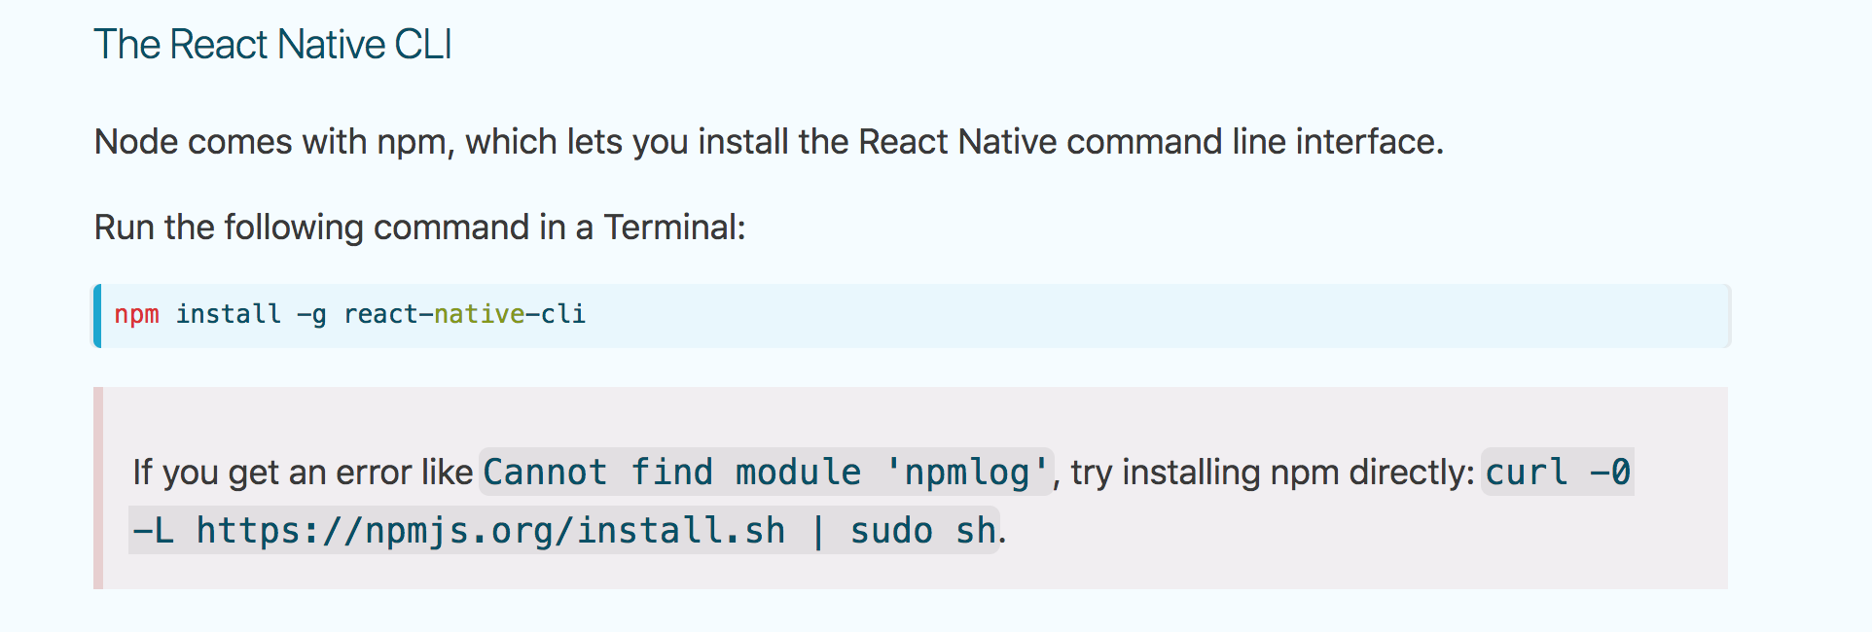

Slide 45
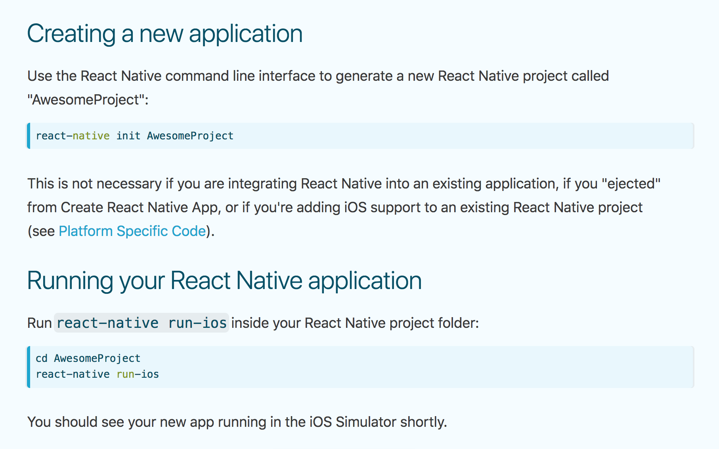

Slide 47
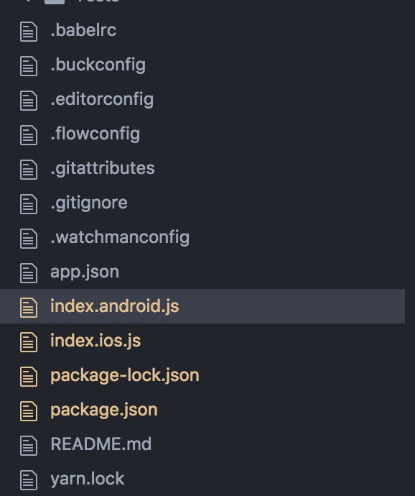
You might run into projects that have two index entry points. All of our projects so far only have ONE entry point: App.js

Slide 48
Consider using boilerplates to save time
https://github.com/infinitered/ignite

Slide 49
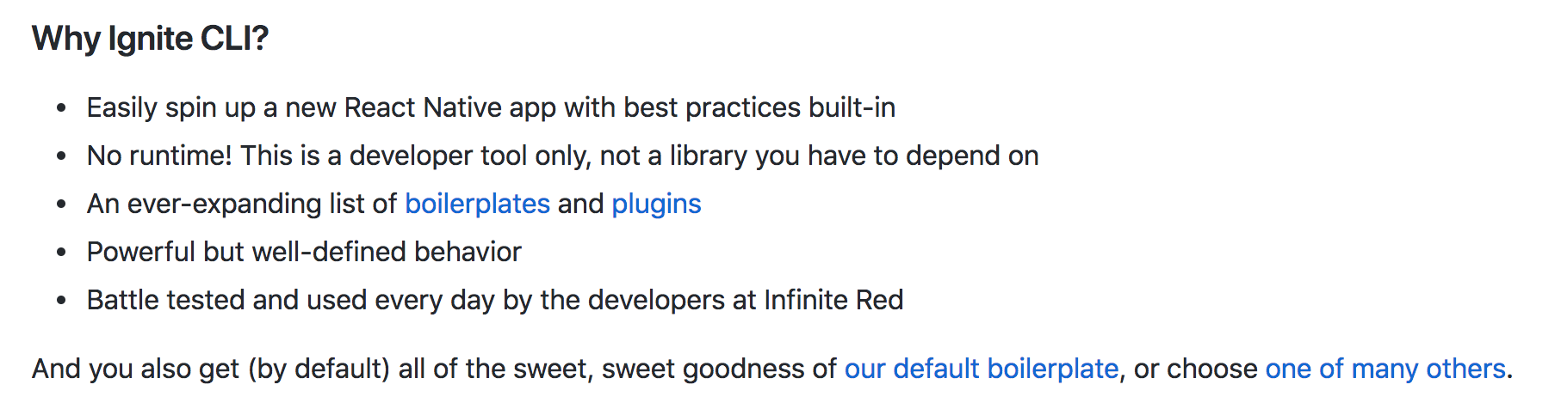
Consider using boilerplates to save time
https://github.com/infinitered/ignite

Slide 50
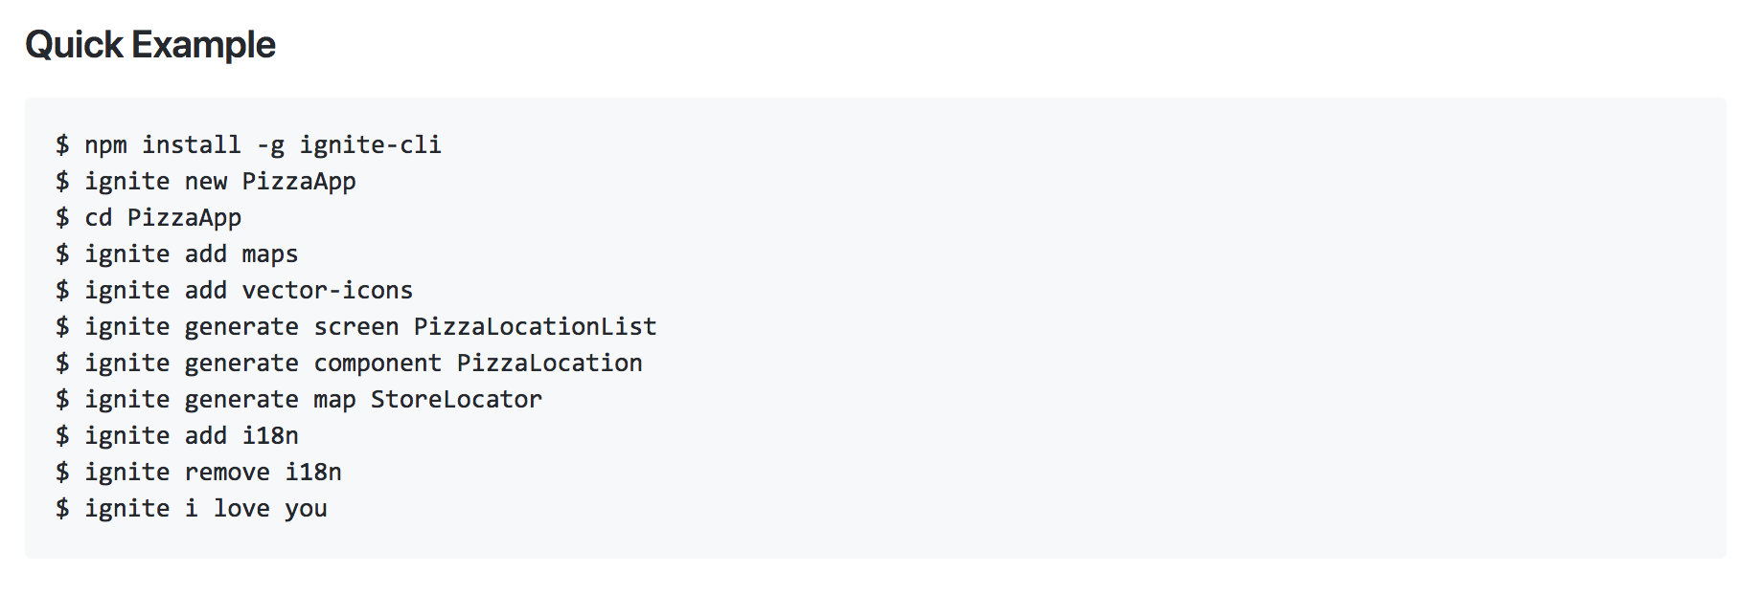
Consider using boilerplates to save time
https://github.com/infinitered/ignite

Slide 51
CS47: Cross-Platform Mobile Development
Lecture 8B: Deploying an App + Detaching
Faculty Advisor
Instructor #1
Fall 2019
https://class.website
class.slack.com

